Slide 1

DEAR
FROM

Slide 2
DEAR
FROM

Slide 3

DEAR
FROM

Slide 4

DEAR
FROM

Slide 5

DEAR
FROM

Slide 6

DEAR
FROM

Slide 7

DEAR
FROM

Slide 8
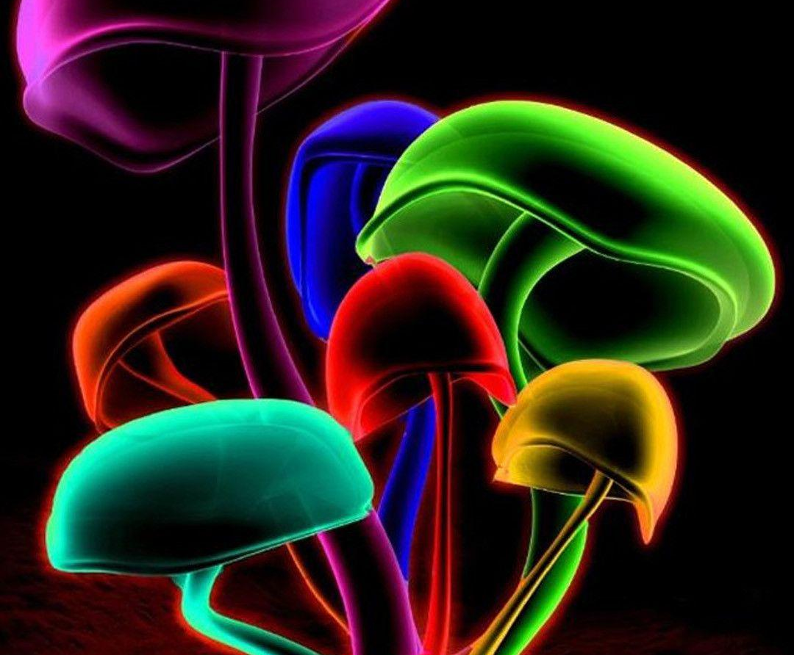

DEAR
FROM

Slide 9

DEAR
FROM

Slide 10

DEAR
FROM

Slide 11
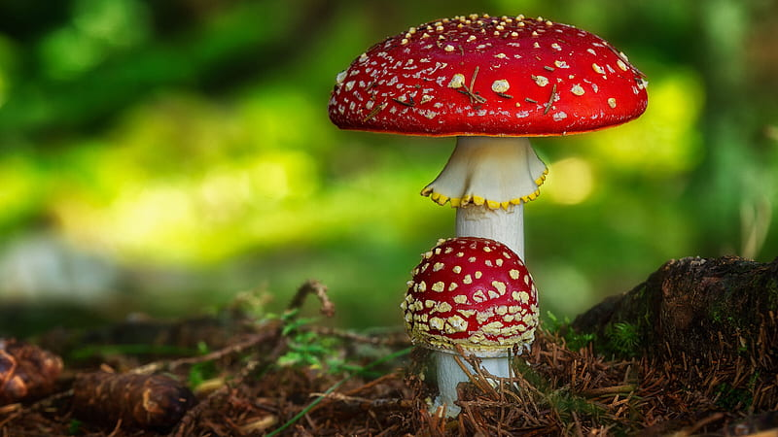
DEAR
FROM

Slide 12

DEAR
FROM

Slide 13

DEAR
FROM

Slide 14

DEAR
FROM

Slide 15

DEAR
FROM

Slide 16
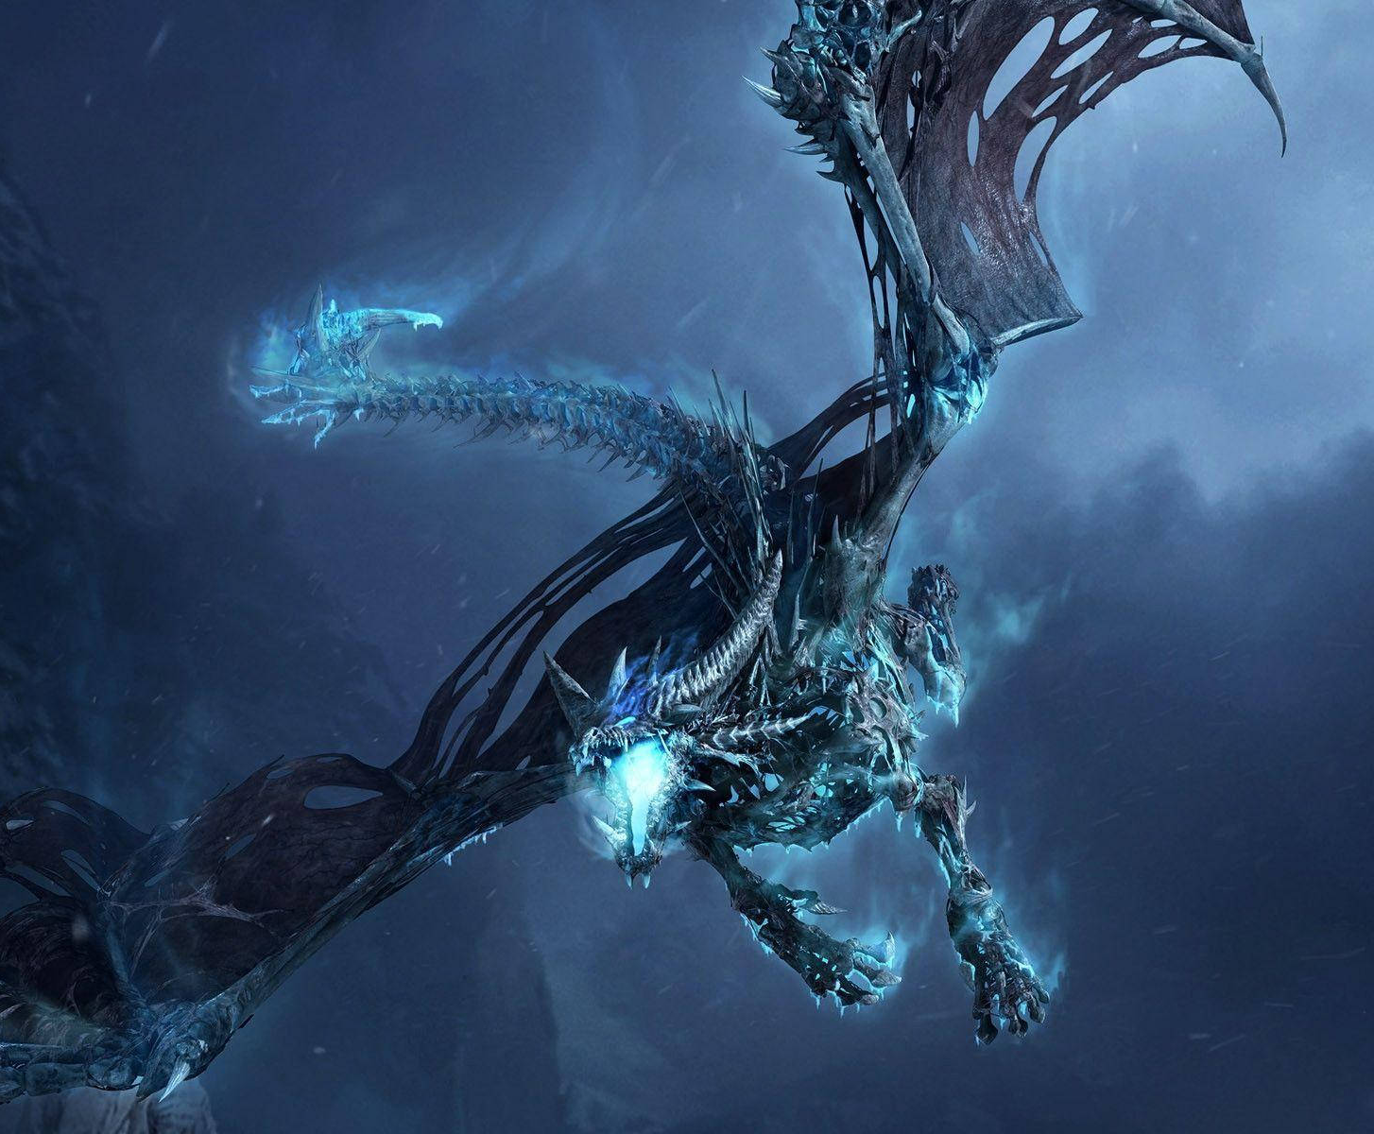
DEAR
FROM

Slide 17

DEAR
FROM

Slide 18
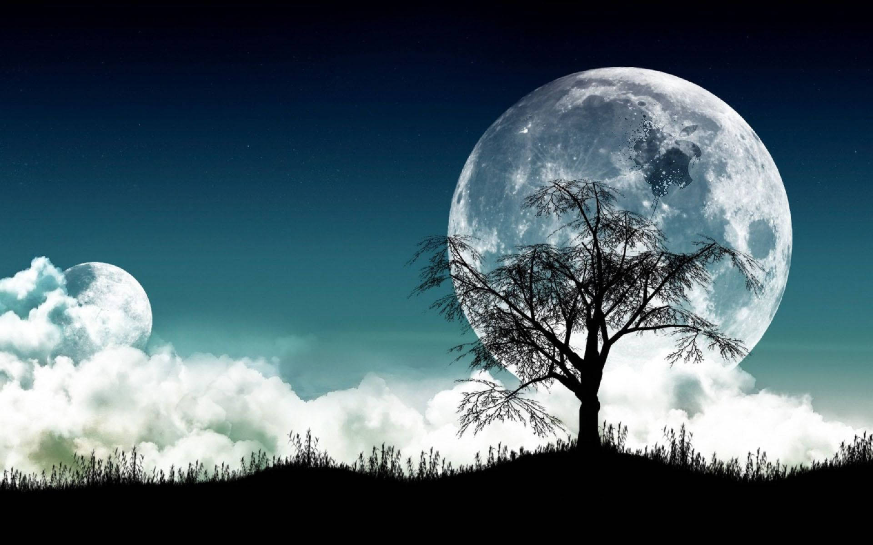
DEAR
FROM

Slide 19

DEAR
FROM

Slide 20

DEAR
FROM

Slide 21

DEAR
FROM

Slide 22

DEAR
FROM

Slide 23
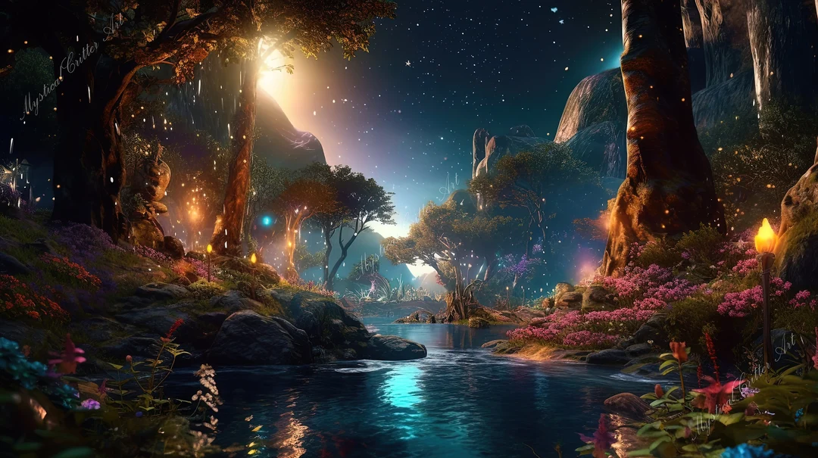
DEAR
FROM

Slide 24

DEAR
FROM

Slide 25

DEAR
FROM

Slide 26

DEAR
FROM

Slide 27

DEAR
FROM

Slide 28

DEAR
FROM

Slide 29

DEAR
FROM

Slide 30

DEAR
FROM

Slide 31

DEAR
FROM

Slide 32
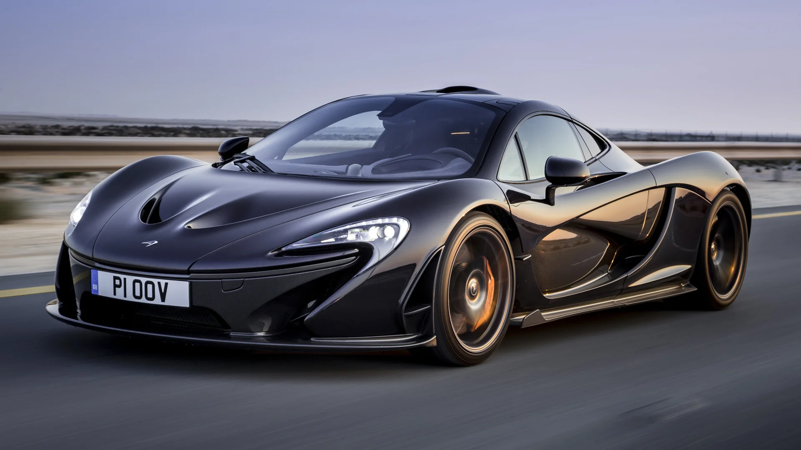
DEAR
FROM

Slide 33
DEAR
FROM

Slide 34

DEAR
FROM

Slide 35

DEAR
FROM

Slide 36

DEAR
FROM

Slide 37

DEAR
FROM

Slide 38

DEAR
FROM

Slide 39

DEAR
FROM

Slide 40

DEAR
FROM

Slide 41
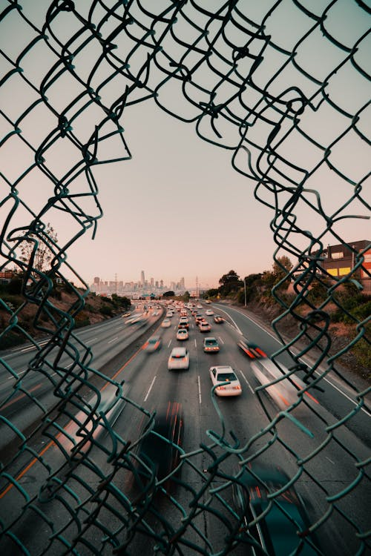
DEAR
FROM

Slide 42

DEAR
FROM

Slide 43

DEAR
FROM

Slide 44
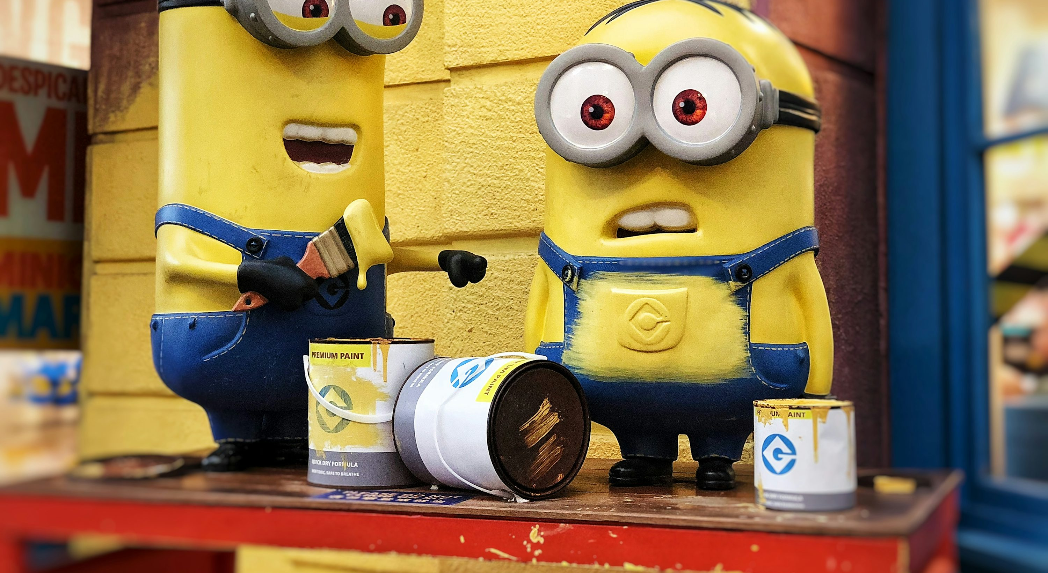
DEAR
FROM

Slide 45

DEAR
FROM

Slide 46

DEAR
FROM

Slide 47

DEAR
FROM

Slide 48

DEAR
FROM

Slide 49

DEAR
FROM

Slide 50
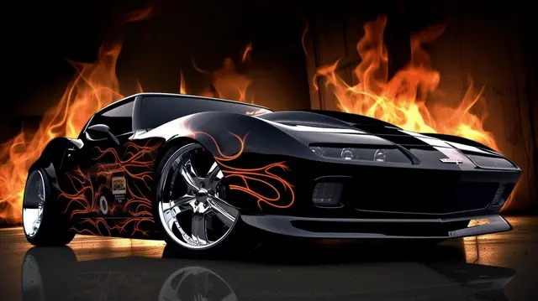
DEAR
FROM

Slide 51
DEAR
FROM

Slide 52

DEAR
FROM

Slide 53
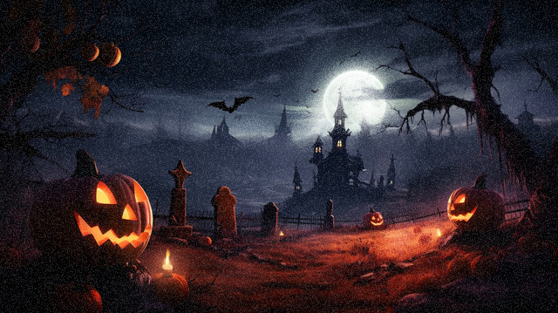
DEAR
FROM

Slide 54
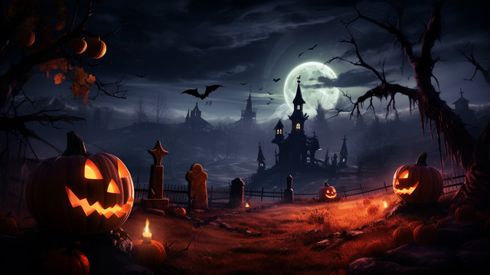
DEAR
FROM

Slide 55

DEAR
FROM

Slide 56

DEAR
FROM

Slide 57

DEAR
FROM

Slide 58

DEAR
FROM

Slide 59

DEAR
FROM

Slide 60
DEAR
FROM

Slide 61
DEAR
FROM

Slide 62

DEAR
FROM

Slide 63

DEAR
FROM

Slide 64
DEAR
FROM

Slide 65
DEAR
FROM

Slide 66
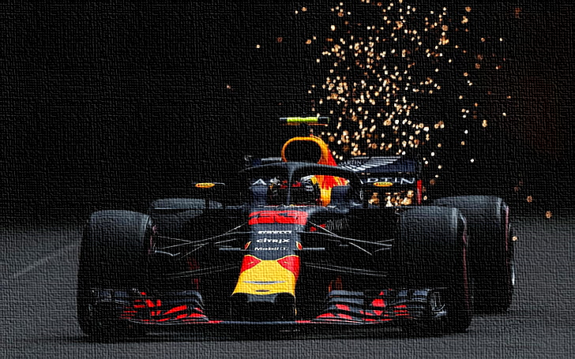
DEAR
FROM

Slide 67

DEAR
FROM

Slide 68
DEAR
FROM

Slide 69
DEAR
FROM

Slide 70

DEAR
FROM

Slide 71
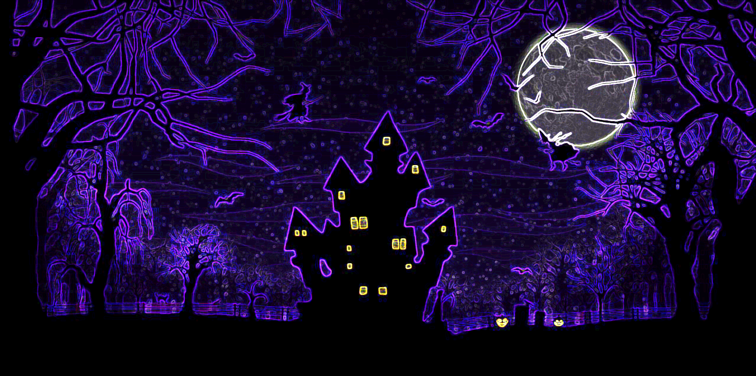
DEAR
FROM

Slide 72
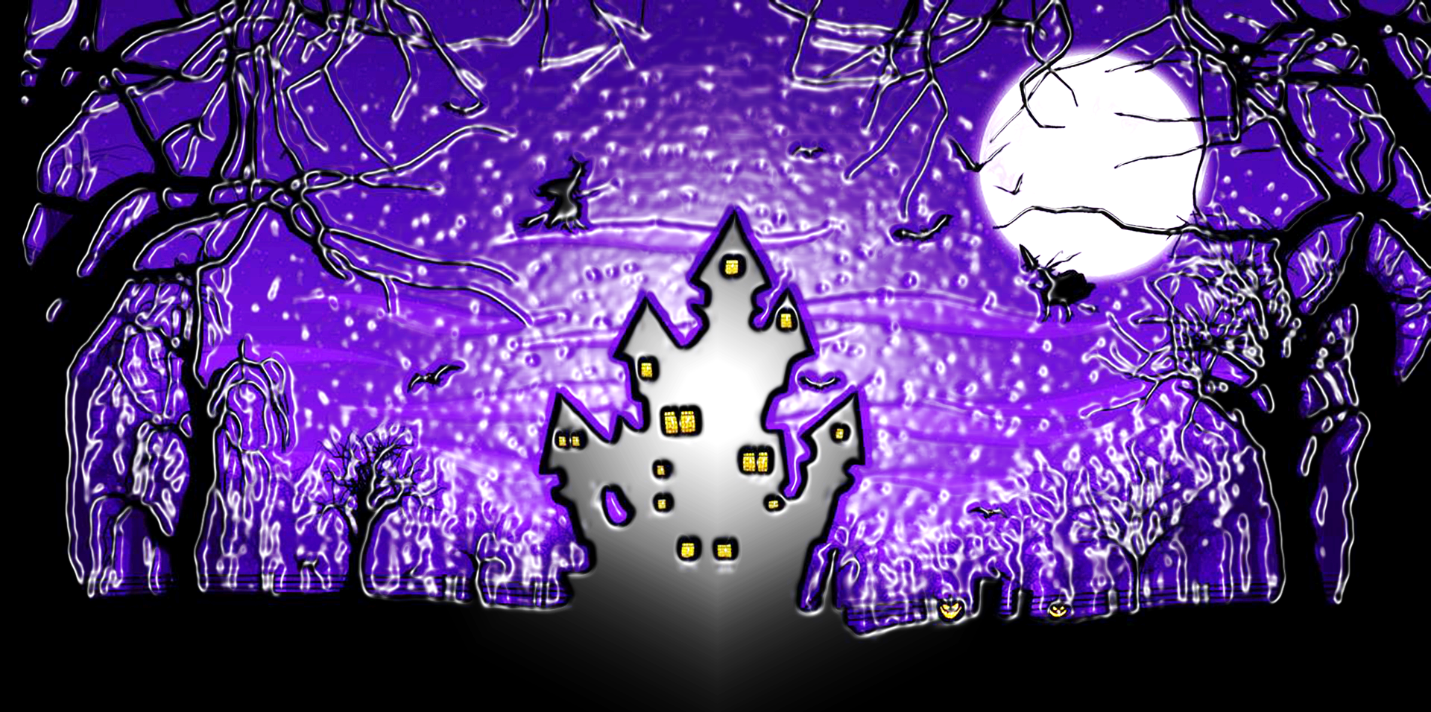
DEAR
FROM

Slide 73

DEAR
FROM

Slide 74

DEAR
FROM

Slide 75

DEAR
FROM

Slide 76

DEAR
FROM

Slide 77

DEAR
FROM

Slide 78
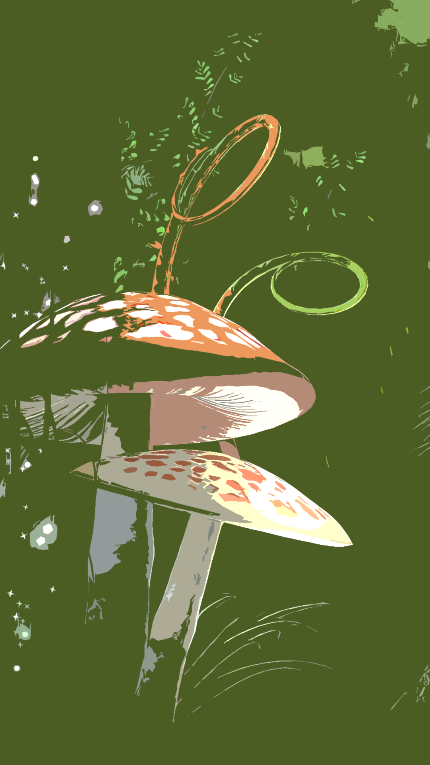
DEAR
FROM

Slide 79
DEAR
FROM

Slide 80
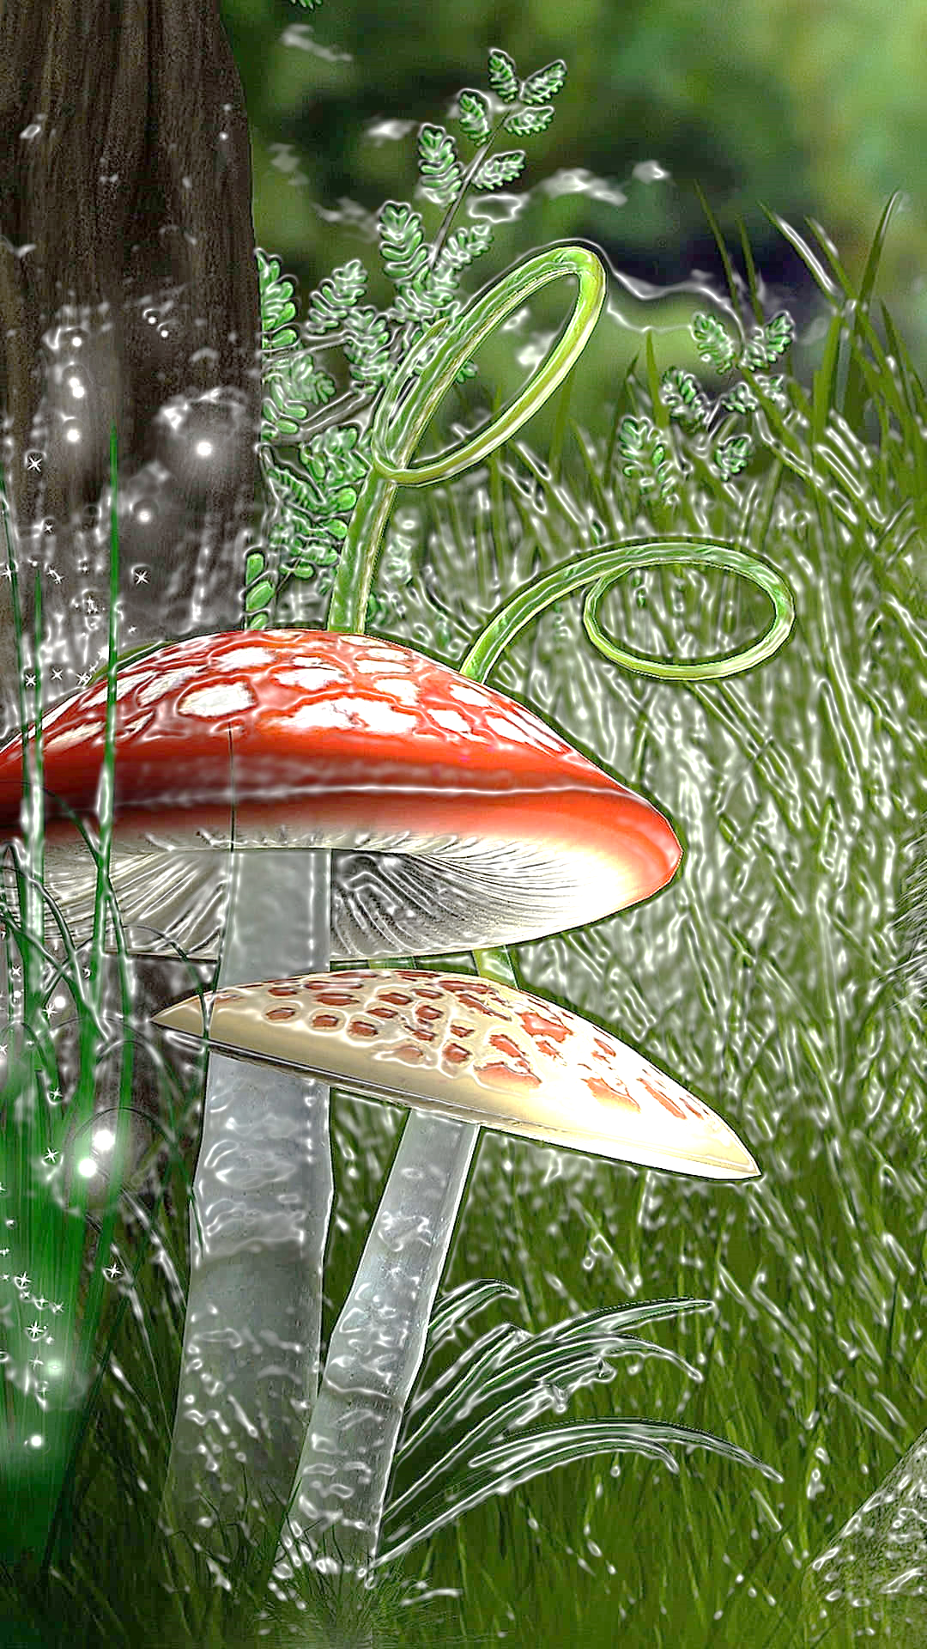
DEAR
FROM

Slide 81
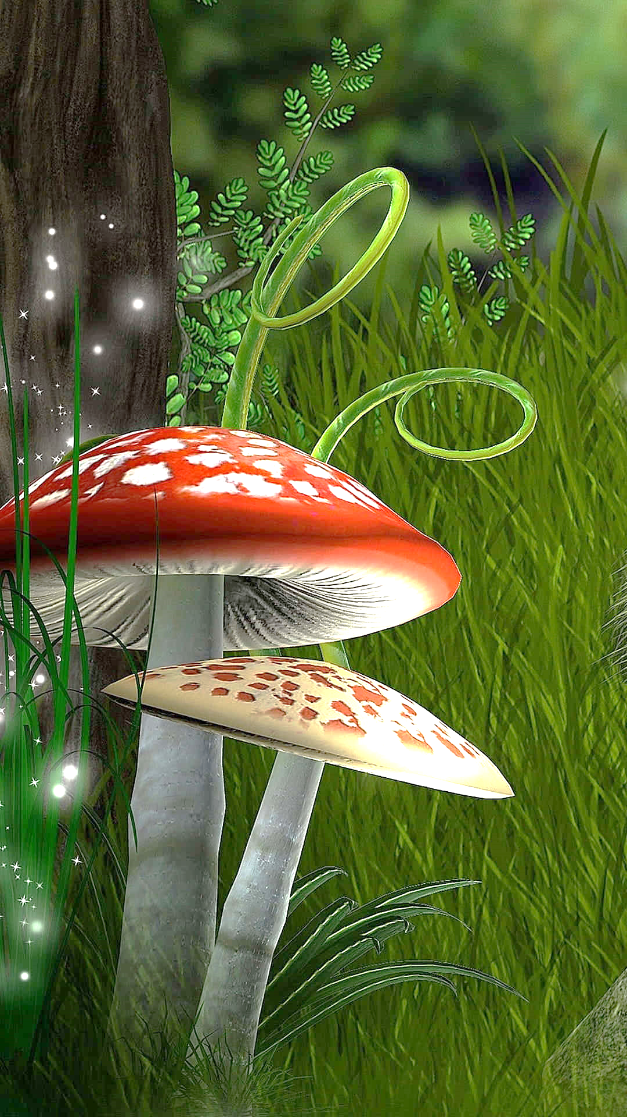
DEAR
FROM

Slide 82
DEAR
FROM

Slide 83
DEAR
FROM

Slide 84
DEAR
FROM

Slide 85

DEAR
FROM

Slide 86

DEAR
FROM

Slide 87
DEAR
FROM

Slide 88
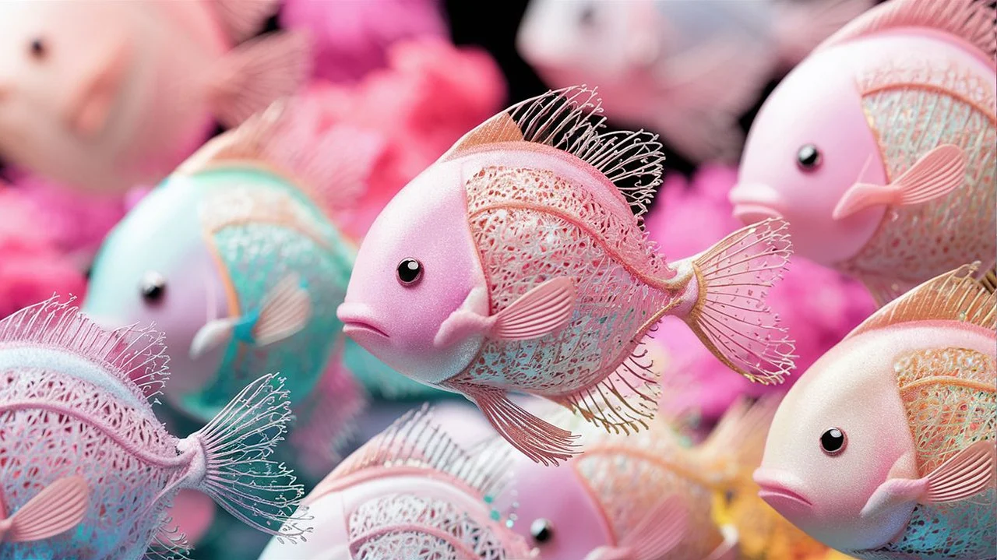
DEAR
FROM

Slide 89
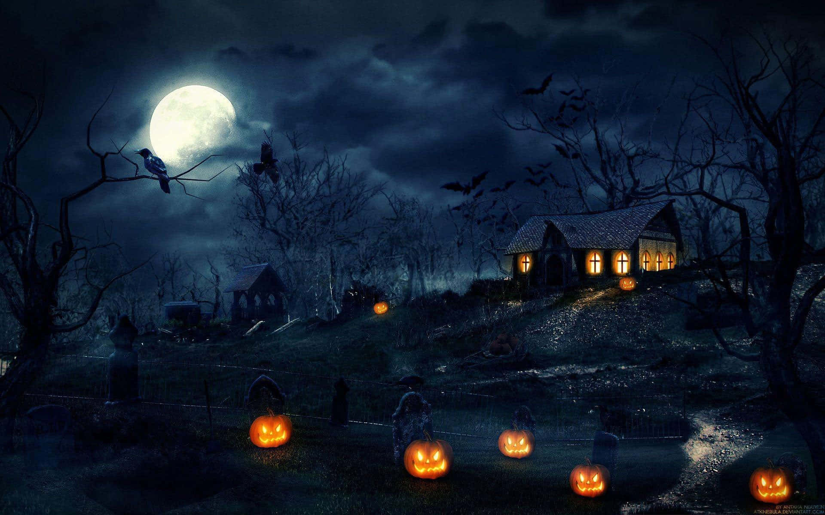
DEAR
FROM

Slide 90
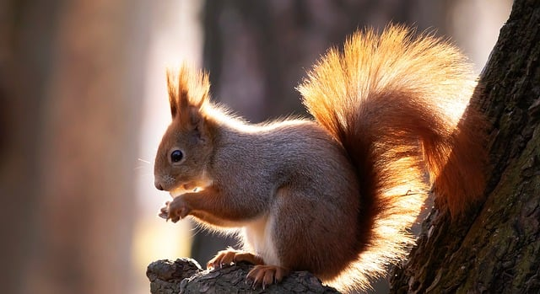
DEAR
FROM

Slide 91

DEAR
FROM

Slide 92

DEAR
FROM

Slide 93

DEAR
FROM

Slide 94

DEAR
FROM

Slide 95
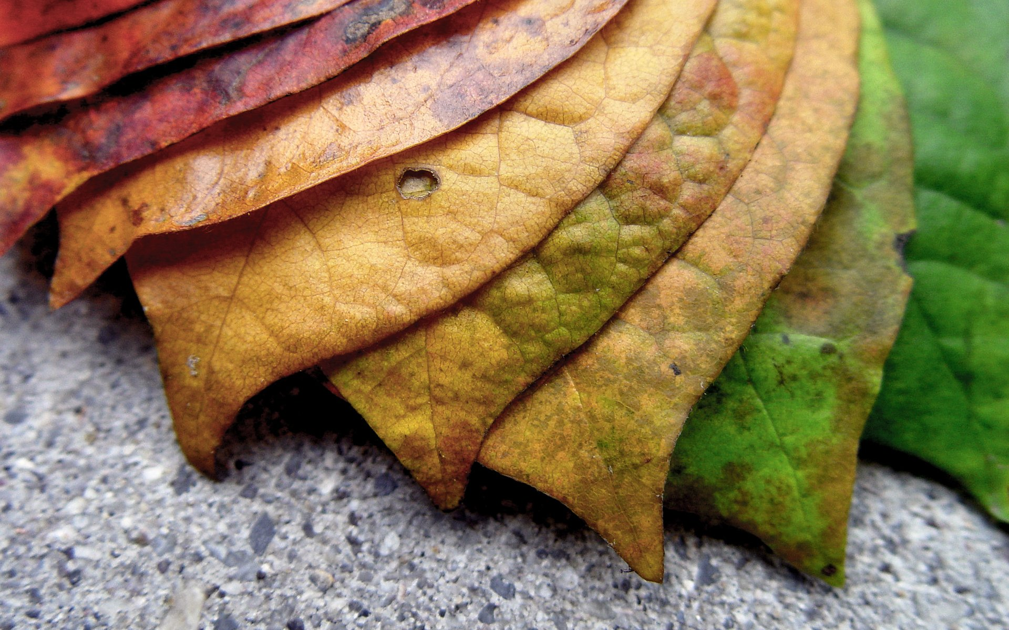
DEAR
FROM

Slide 96

DEAR
FROM

Slide 97
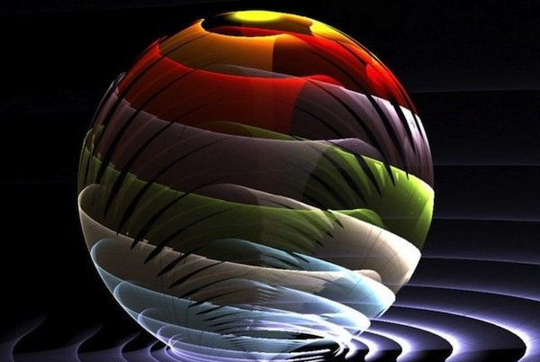
DEAR
FROM

Slide 98

DEAR
FROM

